Slide 1

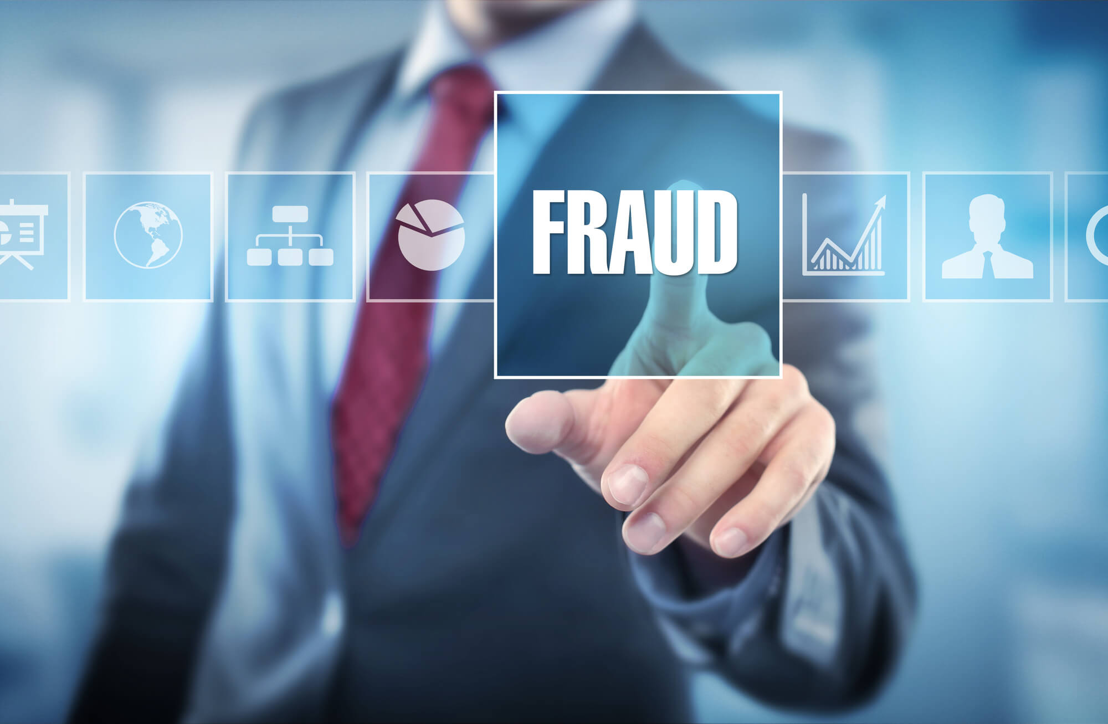
Credit Card Fraud Detection
By
Abdulhadi Abdullah Ayed Alajmi

Slide 2

Introduction
It is important that credit card companies are able to recognize fraudulent credit card transactions so that customers are not charged for items that they did not purchase.
The dataset contains transactions made by credit cards in September 2013 by European cardholders. This dataset presents transactions that occurred in two days, where we have 492 frauds out of 284,807 transactions. The dataset is highly unbalanced, the positive class (frauds) account for 0.172% of all transactions.
In this project , I did some preprocessing analyzing for the dataset to better understanding the data.
Then , I build Credit Card Fraud Detection Prediction model.

Slide 3
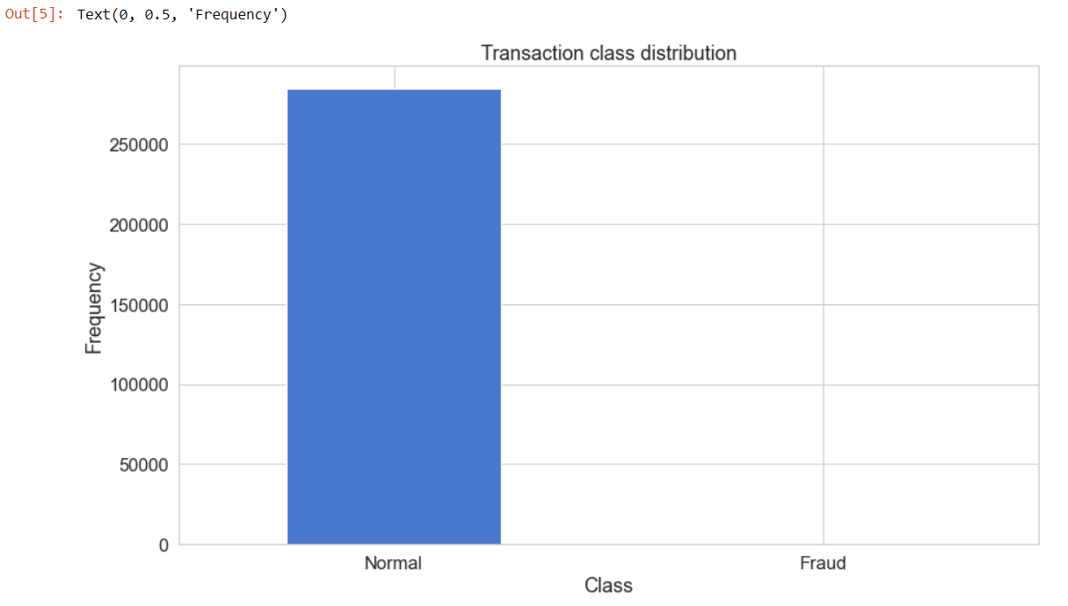
Data Visualization

Slide 4
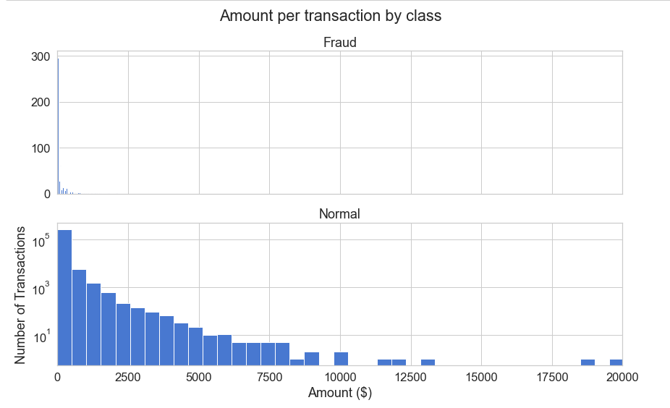
Data Visualization

Slide 5
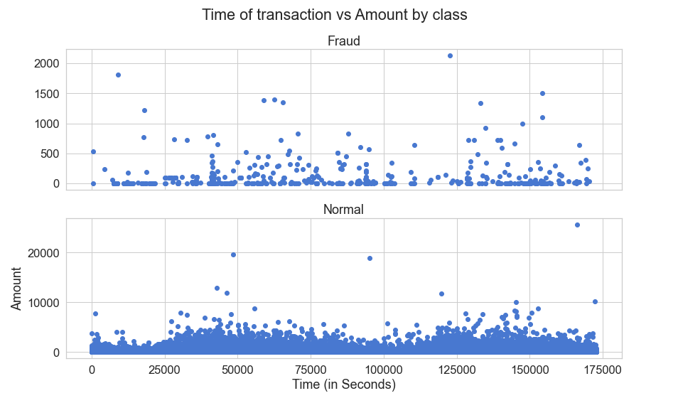
Data Visualization

Slide 6
Machine Learning Models
Autoencoder Model
The reason behind applying this method is to let the model learn the best representation of non-fraudulent cases so that it automatically distinguishes the other case from it.
Logistic Regression
To build Credit Card Fraud Detection Prediction model

Slide 7
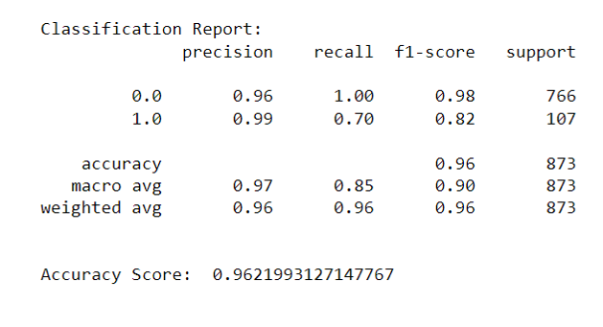
Cross validation

Slide 8
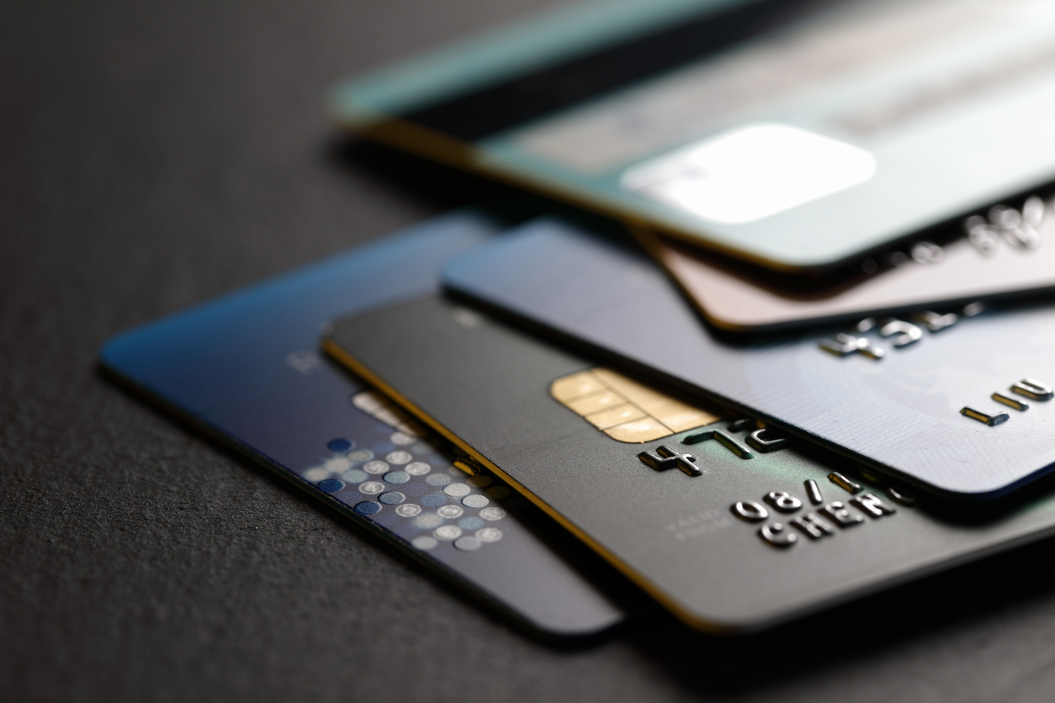
Thank You

